Slide 1
Module 5: Data Bindings to Collections
Binding to Collections of Objects
Presenting Data by Using Collection Views
Presenting Data by Using Data Templates
Notes:
Module 5: Data Binding to Collections
Course 6460A

Slide 2
Lesson: Binding to Collections of Objects
Overview of Binding to Collections
What Is an Observable Collection?
Defining an Observable Collection Class
Introduction to LINQ
Binding to ADO.NET Data Objects
Notes:
Module 5: Data Binding to Collections
Course 6460A

Slide 3

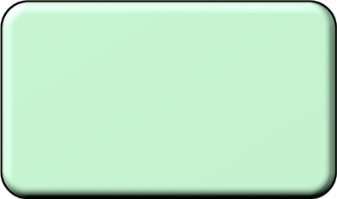
Overview of Binding to Collections
You can bind item controls to a collection of objects
For example: bind a ListBox control to a database result set
Binding Target
Binding Source
ItemsControl Object
Collection Object
Binding Object
ItemsSource Property
Value
OneWay
Notes:
Module 5: Data Binding to Collections
Course 6460A
Ask students if they are familiar with the concept of data binding to collections, and then describe the diagram on the slide.
Question: How does the data collection binding model provided by WPF compare to other implementations that you have used?
Answer: This question is designed to stimulate discussion among the students, so there is no definitive answer.

Slide 4



What Is an Observable Collection?
CollectionChanged
Observable Collection
Mercury
Venus
Earth
Mars
Ceres
Jupiter
Saturn
Uranus
Neptune
Pluto
Eris
Venus
Earth
Mars
Jupiter
Saturn
Uranus
Neptune
ItemsSource
property
New data items
Implements INotifyCollectionChanged
Notes:
Module 5: Data Binding to Collections
Course 6460A
This is an animated slide.
Explain that an observable collection implements the INotifyCollectionChanged interface.
[Click 1] Remind students that you typically bind an ItemsControl such as the ListBox shown on the slide to a data collection by using the ItemsSource property, which populates the list data.
[Click 2] Explain that you can add new data items to an observable collection.
[Click 3] When you add new data items to an observable collection, the collection raises the CollectionChanged event, and then the binding engine updates the ListBox list items.
Question: Would the WPF observable collection model benefit any of your applications?
Answer: This question is designed to stimulate discussion among the students, so there is no definitive answer.

Slide 5
Defining an Observable Collection Class
To define and use an observable collection class:
Define a class that extends ObservableCollection(T)
Create a XAML resource to represent the class, and bind to it
public class NameList : ObservableCollection<Person>
{
...
public class PersonName { ... }
}
<Window ... xmlns:c="clr-namespace:MySample">
<Window.Resources>
<c:NameList x:Key="list"/>
</Window.Resources>
<ListBox ItemsSource =
"{Binding Source={StaticResource list}}"/>
</Window>
Notes:
Module 5: Data Binding to Collections
Course 6460A
Describe the ObservableCollection class. Point out that it is a generic collection class, which means that you specify the types of object that are contained in an ObservableCollection instance.
Refer students to the Course Handbook, which contains a full definition of the NameList class, and then explain how to bind a control to a custom collection class by setting the ItemsSource property to the custom collection class.

Slide 6

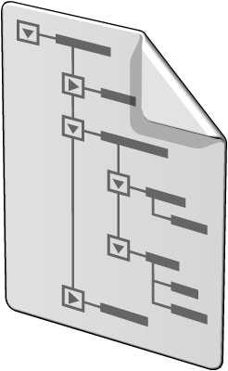
Introduction to LINQ
C#
Visual Basic
Others
.NET Language Integrated Query
Standard
Query
Operators
DLinq
(ADO.NET)
XLinq
(System.Xml)
CLR Objects
Relational Data
XML
Notes:
Briefly describe the background of Language Integrated Query (LINQ) and the reason for its development.
Explain that LINQ enables you to query any object that implements the IEnumerable<T> interface.
Briefly explain the purpose and function of the LINQ to Structured Query Language (SQL) facility (DLinq) and the LINQ to XML facility (XLinq).
This topic provides a foundation for the following topic, which describes binding to ADO.NET data objects by using DLinq.
Question: Would you be able to use LINQ to simplify the process of querying in-memory information in any of your applications?
Answer: This question is designed to stimulate discussion among the students, so there is no definitive answer.
Module 5: Data Binding to Collections
Course 6460A

Slide 7
Binding to ADO.NET Data Objects
WPF enables you to bind to ADO.NET classes such as:
DataSet
DataTable
DataView
To bind to an ADO.NET object:
Populate an ADO.NET object such as DataSet
Set the DataContext property of a control such as ListBox
Create bindings to the required data objects by using properties such as ItemsSource
Notes:
Module 5: Data Binding to Collections
Course 6460A
Explain that Windows® Presentation Foundation (WPF) enables you to create data bindings to any object that implements the IEnumerable interface, which includes ADO.NET objects.
Describe the process for binding to ADO.NET objects. Refer the students to the full code example that is provided in the Course Handbook.

Slide 8
Lesson: Presenting Data by Using Collection Views
What Is a Collection View?
Creating and Using a Collection View
Sorting Data by Using a Collection View
Filtering Data by Using a Collection View
Grouping Data by Using a Collection View
Creating Master-Detail User Interfaces
Notes:
Module 5: Data Binding to Collections
Course 6460A

Slide 9
What Is a Collection View?
Sort
Filter
Group
Mercury
Venus
Earth
Mars
Ceres
Jupiter
Saturn
Uranus
Neptune
Pluto
Eris
Ceres
Earth
Eris
Jupiter
Mars
Mercury
Neptune
Pluto
Saturn
Uranus
Venus
Mercury
Venus
Earth
Mars
Jupiter
Saturn
Uranus
Neptune
Mercury
Venus
Earth
Mars
Jupiter
Saturn
Uranus
Neptune
Ceres
Pluto
Eris
Source Collection
Notes:
Module 5: Data Binding to Collections
Course 6460A
This is an animated slide.
Explain that a collection view provides a layer on top of a binding source collection.
[Click 1] Explain that collection views enable you to display the data based on a sort query.
[Click 2] Explain that collection views enable you to display the data based on a filter query.
[Click 3] Explain that collection views enable you to display the data based on a group query.
Explain that you apply sort, filter, and group queries without manipulating the source data and that you can have multiple collection views on the same source collection.
Question: How does the WPF collection view model compare to other models that you have used?
Answer: This question is designed to stimulate discussion among the students, so there is no definitive answer.

Slide 10
Creating and Using a Collection View
To create and use a collection by using XAML:
Define a CollectionViewSource resource
Bind a user interface control to the resource
<Window.Resources>
<CollectionViewSource
Source="{Binding Source={x:Static Application.Current}, Path=AuctionItems}"
x:Key="listView" />
...
</Window.Resources>
<ListBox
ItemsSource="{Binding Source={StaticResource listView}}">
...
</ListBox>
Notes:
Module 5: Data Binding to Collections
Course 6460A
Explain that you use the CollectionViewSource element to define a collection view by using Extensible Application Markup Language (XAML), and then describe the code examples on the slide in detail.

Slide 11
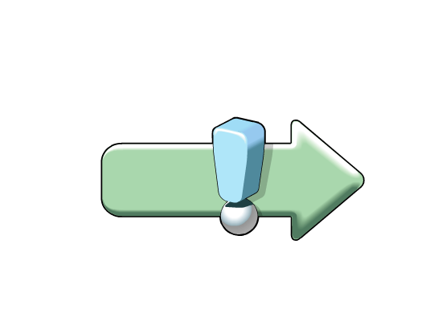
Sorting Data by Using a Collection View
To sort data by using a collection view:
Create a SortDescription object
Add it to the SortDescriptions collection
view.SortDescriptions.Add(
new SortDescription("CategoryName",
ListSortDirection.Ascending));
view.SortDescriptions.Add(
new SortDescription("ProductName",
ListSortDirection.Ascending));
Notes:
Module 5: Data Binding to Collections
Course 6460A
Explain that you add SortDescription objects to the SortDescriptions collection to sort data by using a collection view, and then explain the code example on the slide in detail.

Slide 12
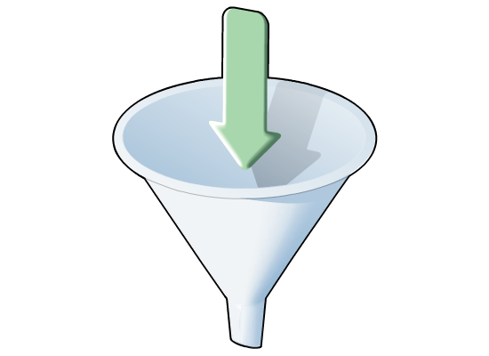
Filtering Data by Using a Collection View
To filter data by using a collection view:
Implement a handler for the Filter event
In the event handler method, accept or reject items
listView.Filter += new FilterEventHandler(ShowBargains);
...
private void ShowBargains(object s, FilterEventArgs e)
{
Product p = e.Item as Product;
if (p != null)
{
if (p.CurrentPrice >= 25)
e.Accepted = false;
else
e.Accepted = true;
}
}
Notes:
Module 5: Data Binding to Collections
Course 6460A
Explain that you implement an event handler method for the Filter method to filter data by using a collection view, and then explain the code example on the slide in detail.

Slide 13
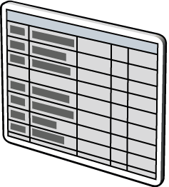
Grouping Data by Using a Collection View
To group data by using a collection view:
Create a PropertyGroupDescription object
Add it to the GroupDescriptions collection
PropertyGroupDescription desc =
new PropertyGroupDescription();
desc.PropertyName = "CategoryName";
listView.GroupDescriptions.Add(desc);
Notes:
Module 5: Data Binding to Collections
Course 6460A
Explain that you add PropertyGroupDescription objects to the GroupDescriptions collection to group data by using a collection view, and then describe the code example on the slide in detail.

Slide 14
Creating Master-Detail User Interfaces
To bind master-detail controls to a collection view:
Define a CollectionViewSource resource
Bind multiple controls to the resource
<ListBox
ItemsSource="{Binding Source={StaticResource listView}}">
...
<ContentControl
Content="{Binding Source={StaticResource view}}">
...
You must set the IsSynchronizedWithCurrentItem property to True if the data source is not a collection
Notes:
Module 5: Data Binding to Collections
Course 6460A
Explain that CollectionViewSource objects automatically synchronize currency and selection. If the ListBox control is not bound to a CollectionViewSource object (as in this example), you would need to set its IsSynchronizedWithCurrentItem property to True for this to work.
Question: How does the WPF master-detail data-binding model compare to other technologies that you have used?
Answer: This question is designed to stimulate discussion among the students, so there is no definitive answer.

Slide 15
Lesson: Presenting Data by Using Data Templates
What Is a Data Template?
Defining and Using a Data Template
Defining a Data Template as a Resource
Using Data Triggers in a Data Template
Notes:
Module 5: Data Binding to Collections
Course 6460A

Slide 16
What Is a Data Template?
Andy Jacobs
43
Robert Brown
34
Kelly Krout
63
Lola Jacobsen
23
MySample.Person
MySample.Person
MySample.Person
MySample.Person
Data Template
Notes:
Module 5: Data Binding to Collections
Course 6460A
This is an animated slide.
Explain that, by default, a control calls the ToString method to display objects in a collection. Explain that overriding the ToString method is a possible solution, but it is limiting and inflexible.
[Click 1] Explain that you use a data template to define the visual structure of your data objects.
Question: How could you use the WPF data-templating model in your own applications?
Answer: This question is designed to stimulate discussion among the students, so there is no definitive answer.

Slide 17
Defining and Using a Data Template
To define and use a data template:
Define a DataTemplate element
Add it to the ItemTemplate or ContentTemplate property
<ListBox
ItemsSource="{Binding Source={StaticResource list}}">
<ListBox.ItemTemplate>
<DataTemplate>
<StackPanel>
<TextBlock Text="{Binding Path=FirstName}" />
<TextBlock Text="{Binding Path=LastName}"/>
</StackPanel>
</DataTemplate>
</ListBox.ItemTemplate>
</ListBox>
Notes:
Module 5: Data Binding to Collections
Course 6460A
Explain the syntax for defining a data template. Point out that the example in the slide assigns the data template to the ItemTemplate property on a ListBox. Also refer students to the Course Handbook, which describes how to define a data template and assign it to the ContentTemplate property of a content control.

Slide 18
Defining a Data Template as a Resource
You define reusable data templates as resources by setting the x:Key or DataType property on the DataTemplate
<Window.Resources>
<DataTemplate x:Key="myDataTemplate">
<StackPanel>
<TextBlock Text="{Binding Path=FirstName}" />
<TextBlock Text="{Binding Path=LastName}"/>
</StackPanel>
</DataTemplate>
</Window.Resources>
<ListBox
ItemsSource="{Binding Source={StaticResource list}}"
ItemTemplate="{StaticResource myDataTemplate}" />
Notes:
Module 5: Data Binding to Collections
Course 6460A
Describe how to define a data template as a resource, and remind students that this enables multiple controls to use the data template. Explain that the x:Key property defines a specific name for the data template, and controls must explicitly set their ItemTemplate or ContentTemplate property to use this data template.
Refer students to the example in the Course Handbook that shows how to set the DataType property for a data template. Explain the syntax for defining a data template that has a DataType property and explain what this means.

Slide 19
Using Data Triggers in a Data Template
To define a data trigger:
Define a DataTrigger element
Set the Binding and Value properties on the DataTrigger
Add Setter child elements to set control properties
<DataTemplate x:Key="myDataTemplate">
<DataTemplate.Triggers>
<DataTrigger Binding="{Binding Path=Gender}"
Value="Male">
<Setter TargetName="border"
Property="Foreground"
Value="Blue"/>
</DataTrigger>
</DataTemplate.Triggers>
</DataTemplate>
Notes:
Module 5: Data Binding to Collections
Course 6460A
The example in the slide defines a data trigger that detects objects in the underlying collection that have a Gender property with the value Male. For such objects, the data trigger sets the UI control to have a blue border.
Question: How could you use data triggers in your own applications?
Answer: This question is designed to stimulate discussion among the students, so there is no definitive answer.

Slide 20
Lab: Binding User Interface Elements to Collections
Exercise 1: Presenting Data by Using Collection Views
Exercise 2: Presenting Data by Using Data Templates
Logon information
Virtual machine | 6460A-LON-DEV-05
User name | Student
Password | Pa$$w0rd
Estimated time: 60 minutes
Notes:
In this lab, students will add data bindings to collections in a WPF application.
Exercise 1
In this exercise, students will implement sorting, filtering, and grouping functionality for the patient search results by using a collection view.
Exercise 2
In this exercise, students will enhance the UI by implementing data templates for the group header of the patient search results list and for the appointments list.
Before the students begin the lab, read the scenario associated with each exercise to the class.
Module 5: Data Binding to Collections
Course 6460A

Slide 21
Lab Review
How do you apply a sort expression to a collection view?
How do you define a data template that applies to a particular type?
Notes:
Module 5: Data Binding to Collections
Course 6460A
Use the questions on the slide to guide the debriefing after students have completed the lab exercises.
Question: How do you apply a sort expression to a collection view?
Answer: You add SortDescription objects to the SortDescriptions property of a collection view to apply a sort expression.
Question: How do you define a data template that applies to a particular type?
Answer: You define the data template in the resources section and specify the required type in the DataType property to define a data template that applies to that type.

Slide 22
Module Review and Takeaways
Review Questions
Best Practices
Tools
Notes:
Module 5: Data Binding to Collections
Course 6460A
Review Questions
Point the students to the appropriate section in the course so that they are able to answer the questions in this section.
Best Practices
Help the students understand the best practices presented in this section. Ask students to consider these best practices in the context of their own business situations.
Tools
Point out the location from which each key tool can be installed. Let students review the function and usage of each tool on their own. Remind students that they can use this as a master list to help them gather all the tools required to facilitate their application support work.

